Slide 1
7 Algorithm design and problem-solving
Suitable test data

Slide 2
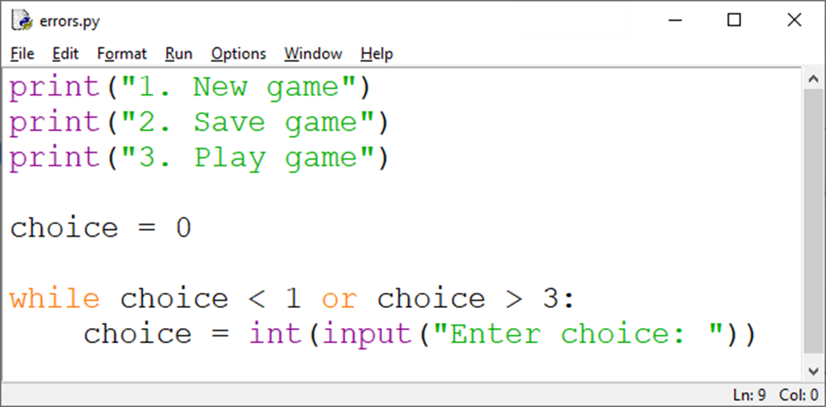
Suitable test data
Let’s look at range of suitable test data for this simple program.

Slide 3
Suitable test data
No. | Type of test | Input | Expected output
1 | No data |  | Reject input
2 | Normal data | 2 | Accept input
3 | Abnormal data | j | Reject input
4 | Abnormal data | # | Reject input
5 | Abnormal data | -6 | Reject input
6 | Extreme data Boundary data | 1 | Accept input
7 | Extreme data Boundary data | 3 | Accept input
8 | Boundary data | 0 | Reject input
9 | Boundary data | 4 | Reject input

Slide 4
Suitable test data
No. | Type of test | Input | Expected output
1 | No data |  | Reject input
2 | Normal data | 2 | Accept input
3 | Abnormal data | j | Reject input
4 | Abnormal data | # | Reject input
5 | Abnormal data | -6 | Reject input
6 | Extreme data Boundary data | 1 | Accept input
7 | Extreme data Boundary data | 3 | Accept input
8 | Boundary data | 0 | Reject input
9 | Boundary data | 4 | Reject input
No data
You should always check the special case of no data being entered – this isn’t strictly invalid or abnormal data, but it certainly isn’t what you want the user to do.

Slide 5
Suitable test data
No. | Type of test | Input | Expected output
1 | No data |  | Reject input
2 | Normal data | 2 | Accept input
3 | Abnormal data | j | Reject input
4 | Abnormal data | # | Reject input
5 | Abnormal data | -6 | Reject input
6 | Extreme data Boundary data | 1 | Accept input
7 | Extreme data Boundary data | 3 | Accept input
8 | Boundary data | 0 | Reject input
9 | Boundary data | 4 | Reject input
Abnormal data
Data that should be rejected by the program.

Slide 6
Suitable test data
No. | Type of test | Input | Expected output
1 | No data |  | Reject input
2 | Normal data | 2 | Accept input
3 | Abnormal data | j | Reject input
4 | Abnormal data | # | Reject input
5 | Abnormal data | -6 | Reject input
6 | Extreme data Boundary data | 1 | Accept input
7 | Extreme data Boundary data | 3 | Accept input
8 | Boundary data | 0 | Reject input
9 | Boundary data | 4 | Reject input
Normal data
Data that should be accepted without causing errors.

Slide 7
Suitable test data
No. | Type of test | Input | Expected output
1 | No data |  | Reject input
2 | Normal data | 2 | Accept input
3 | Abnormal data | j | Reject input
4 | Abnormal data | # | Reject input
5 | Abnormal data | -6 | Reject input
6 | Extreme data Boundary data | 1 | Accept input
7 | Extreme data Boundary data | 3 | Accept input
8 | Boundary data | 0 | Reject input
9 | Boundary data | 4 | Reject input
Extreme data
Data that is the largest/smallest acceptable value.

Slide 8
Suitable test data
No. | Type of test | Input | Expected output
1 | No data |  | Reject input
2 | Normal data | 2 | Accept input
3 | Abnormal data | j | Reject input
4 | Abnormal data | # | Reject input
5 | Abnormal data | -6 | Reject input
6 | Extreme data Boundary data | 1 | Accept input
7 | Extreme data Boundary data | 3 | Accept input
8 | Boundary data | 0 | Reject input
9 | Boundary data | 4 | Reject input
Boundary data
Data that is the largest/smallest acceptable value as well as the corresponding smallest/largest rejected value.

Slide 9
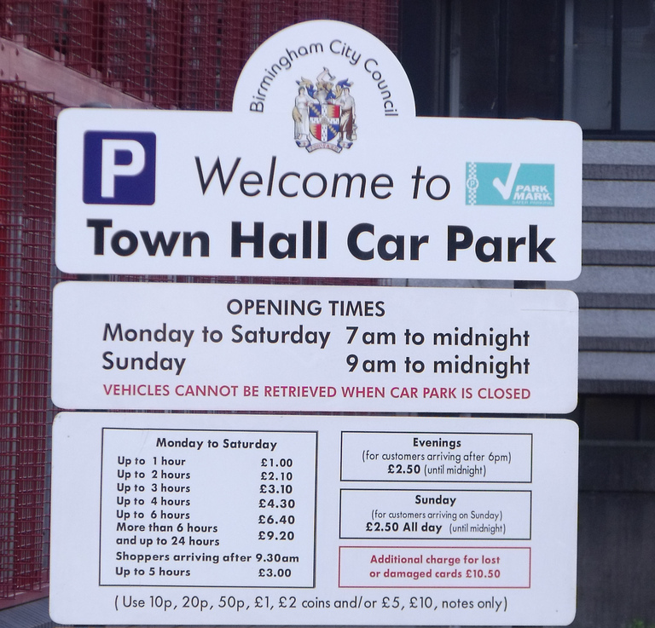
Suitable test data
What data could be used for this car park ticket machine software?

Slide 10
Suitable test data
What data could be used for this car park ticket machine software?

Slide 11
Suitable test data
What data could be used for this car park ticket machine software?

Slide 12
Suitable test data
What data could be used for this car park ticket machine software?

Slide 13
Suitable test data
What data could be used for this car park ticket machine software?
½ hour parking
1 hour parking
1 ½ hour parking
Sunday parking
Evening parking past 7pm
Parking before 9:30am
Parking after 9:30am
Parking during invalid opening hours

Slide 14

Suitable test data
Test data needs to include a range of:
Normal inputs: Data that should be accepted without causing errors.
Abnormal inputs: Data that should be rejected by the program – includes no input when one is expected.
Boundary inputs: Data that is the largest/smallest acceptable value as well as the corresponding smallest/largest rejected value.
Extreme data: Data that is the largest/smallest acceptable value.

Slide 15


